Slide 1
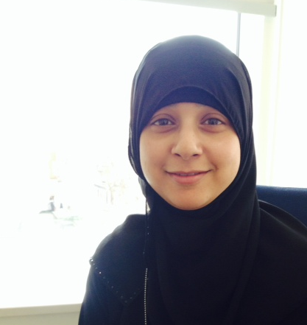
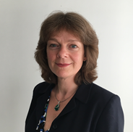
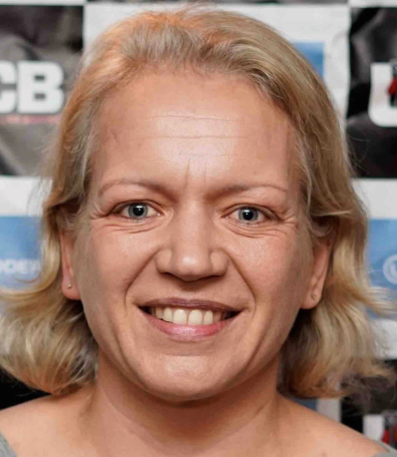
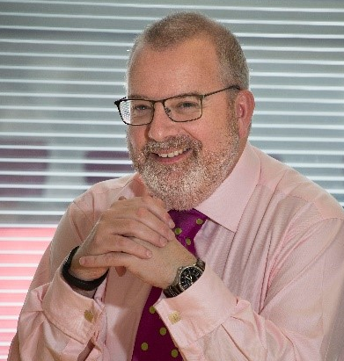
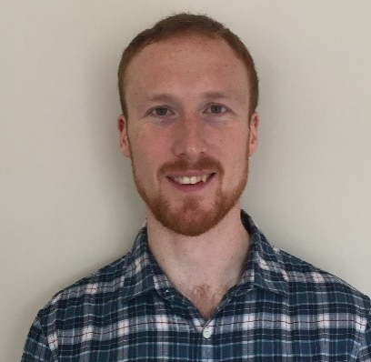
Science & Engineering Career Paths in Government
Sadeka Arefin
Head of People Capability, GSE Profession (Session Chair)
Alison Baptiste
Director of Public and Security Services, Infrastructure and Projects Authority (IPA)
Naomi Roberts
Head of Scientific Advice, Defence Science & Technology, MoD
Professor Andrew Curran
Chief Scientific Adviser (CSA) at the Health and Safety Executive (HSE)
Nick Daly
Science & Engineering Fast Streamer (SEFS), Co-founder of the Fast Stream Science & Technology Network
Francis Mosley
Senior Innovation and Systems Engineer at Ofgem (and
former SEFS)

Slide 2
Key Resources
GSE Employee Value Proposition (EVP) Document –
Contains all the resources the GSE profession can offer to support members (including everything on this slide).
GSE Career Framework –
The GSE career framework outlines the skills, knowledge and experience required to be an effective scientist or engineer in government.
GSE Skills Assessment Tool –
This is an online, interactive, personal development tool for all GSE members which supports your career aims, skills, and learning.
Support for Civil Service talent scheme applicants –
The GSE profession provides support and help in preparing for interview for members who wish to progress their careers through a corporate talent scheme (e.g. Future Leaders Scheme).
GSE Newsletter –
Careers information as well as important news, events, L&D and networking. You will receive this automatically as a member of the profession.

