Slide 1
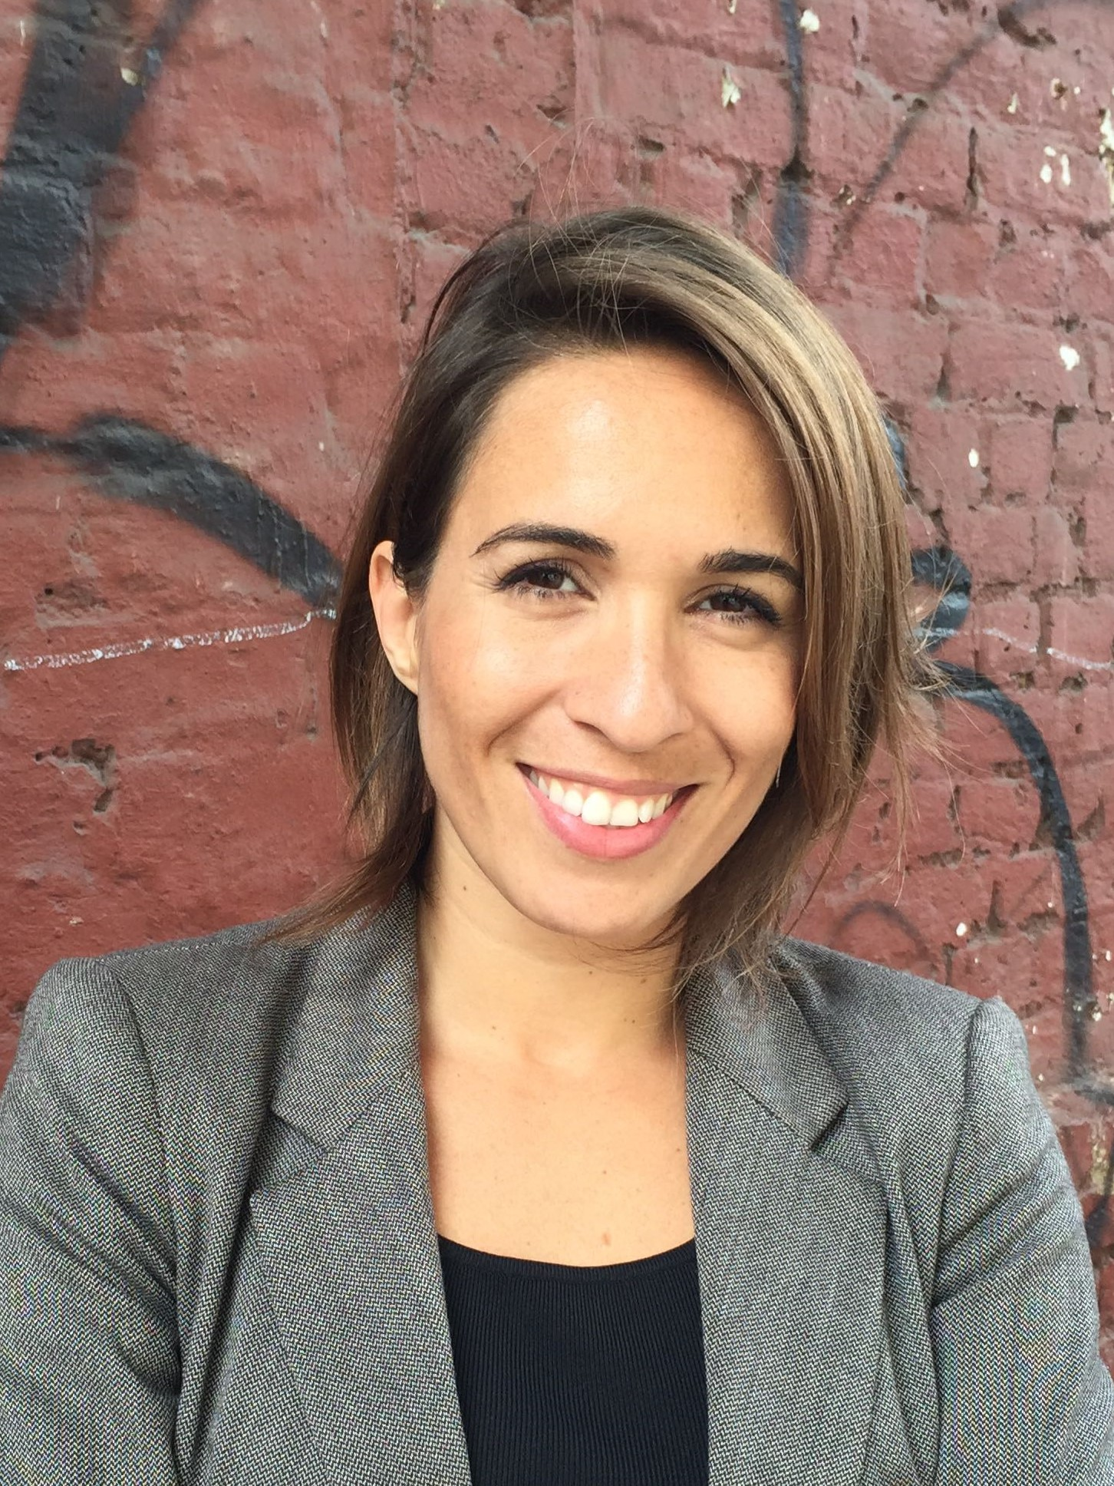
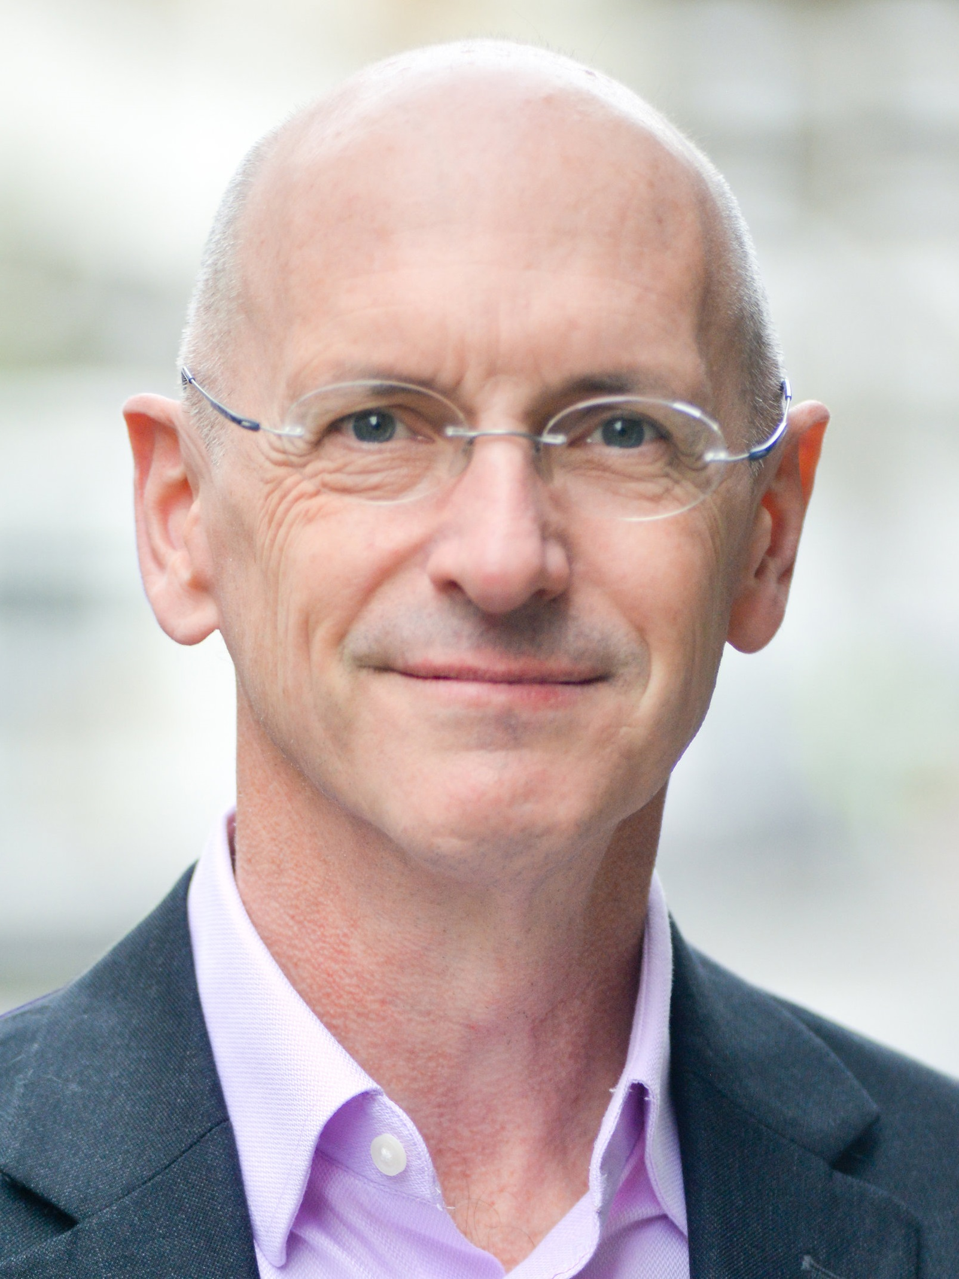
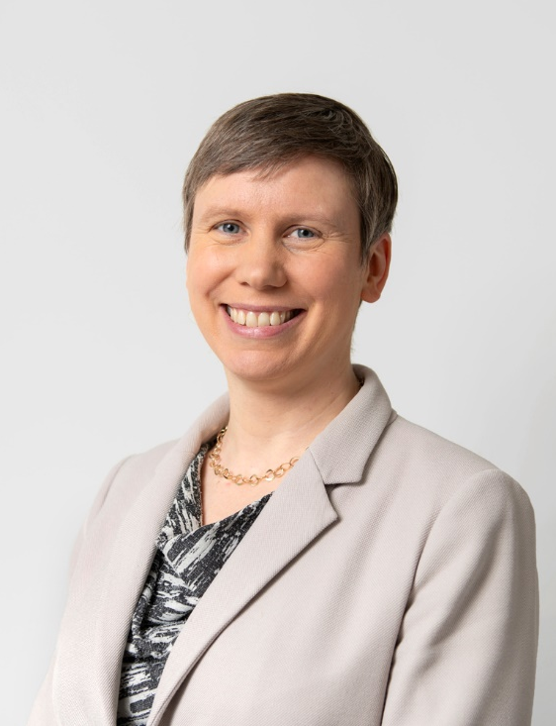
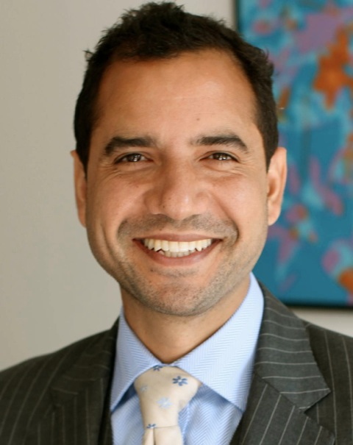
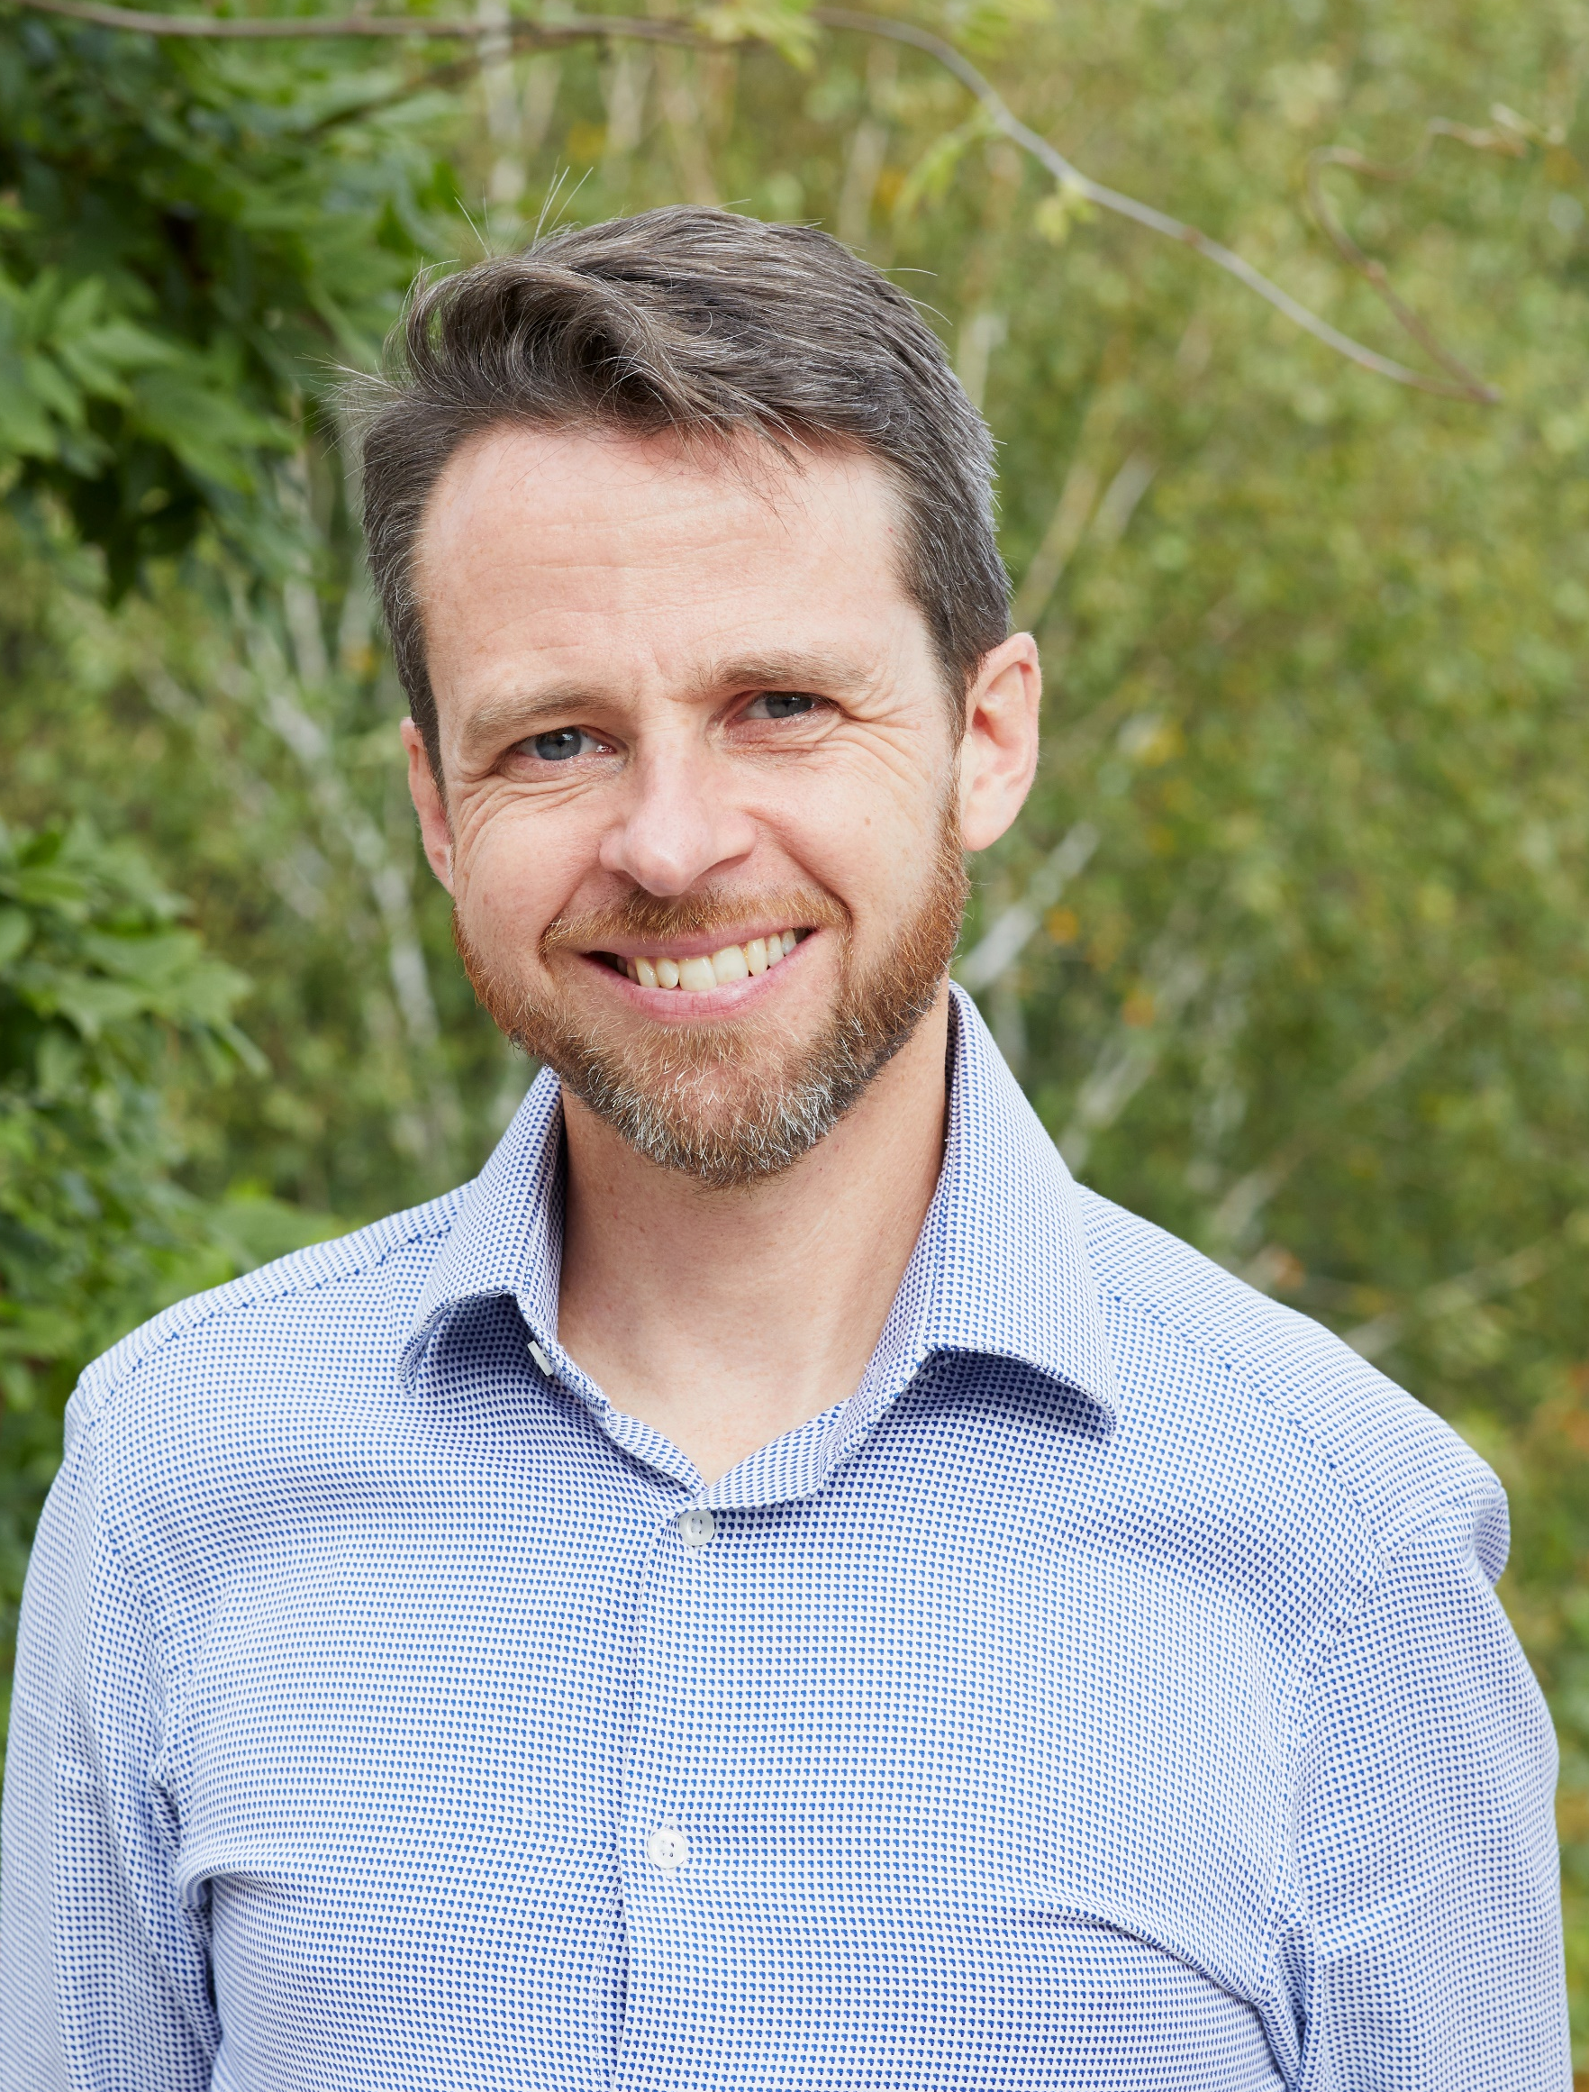
Sustainable Cities Panel Event
Helena Monteiro
Making Cities Resilient 2030 Coordinator at the UN Office for Disaster Risk Reduction
Shaun Spiers
Executive Director – Green Alliance
Catherine Barber
Assistant Director, Environment and Energy – Greater London Authority
Agamemnon Otero
CEO of Energy Garden, co-founder of Repowering, Brixton Energy, Community Energy England
Jamie Clarke
Executive Director – Climate Outreach

