Slide 1
Looking at GSE expertise & interchange
Claire Meara (Go-Science) Dr Richard Burguete (National Physical Laboratory) Simon Brindle (Gov Wales)
Notes:
This session is looking at GSE expertise and interchange. Presented by Claire Meara from the GSE Profession team in Go-Science, with panellists Dr Richard Burguete from the NPL, and Simon Brindle as Head of Policy Profession for Welsh Government.

Slide 2
Session objectives
Raise awareness of GSE activities related to improving STEM knowledge exchange programs to support development.
Through panel discussion:
explore barriers to knowledge exchange programs, and
explore how we could use knowledge exchange programs to embed STEM into policy.
Gather your views and awareness of existing schemes through our post-session questionnaire.
Notes:
In this presentation, we want to raise your awareness of the ongoing activities in the GSE Profession to develop better STEM knowledge exchange programs, these programs are designed to help you gain or maintain skills from working across and outside of government. By knowledge exchange programs, we mean a variety of options, including secondments, placements, fellowships, loans, and/or internships.
After going through our ongoing activities, we’re going to have a panel discussion where we will explore barriers to using and employing good STEM knowledge exchange programs, and explore how knowledge exchange programs could be used to embed STEM into policymaking teams. For a lively discussion, we’re hoping for lots of great questions from the audience, so shout out at the end!
We’re also hoping that you will all complete our post-session survey which will help capture what existing schemes you’re aware of and how they could be improved to help develop and embed STEM skills across government.

Slide 3
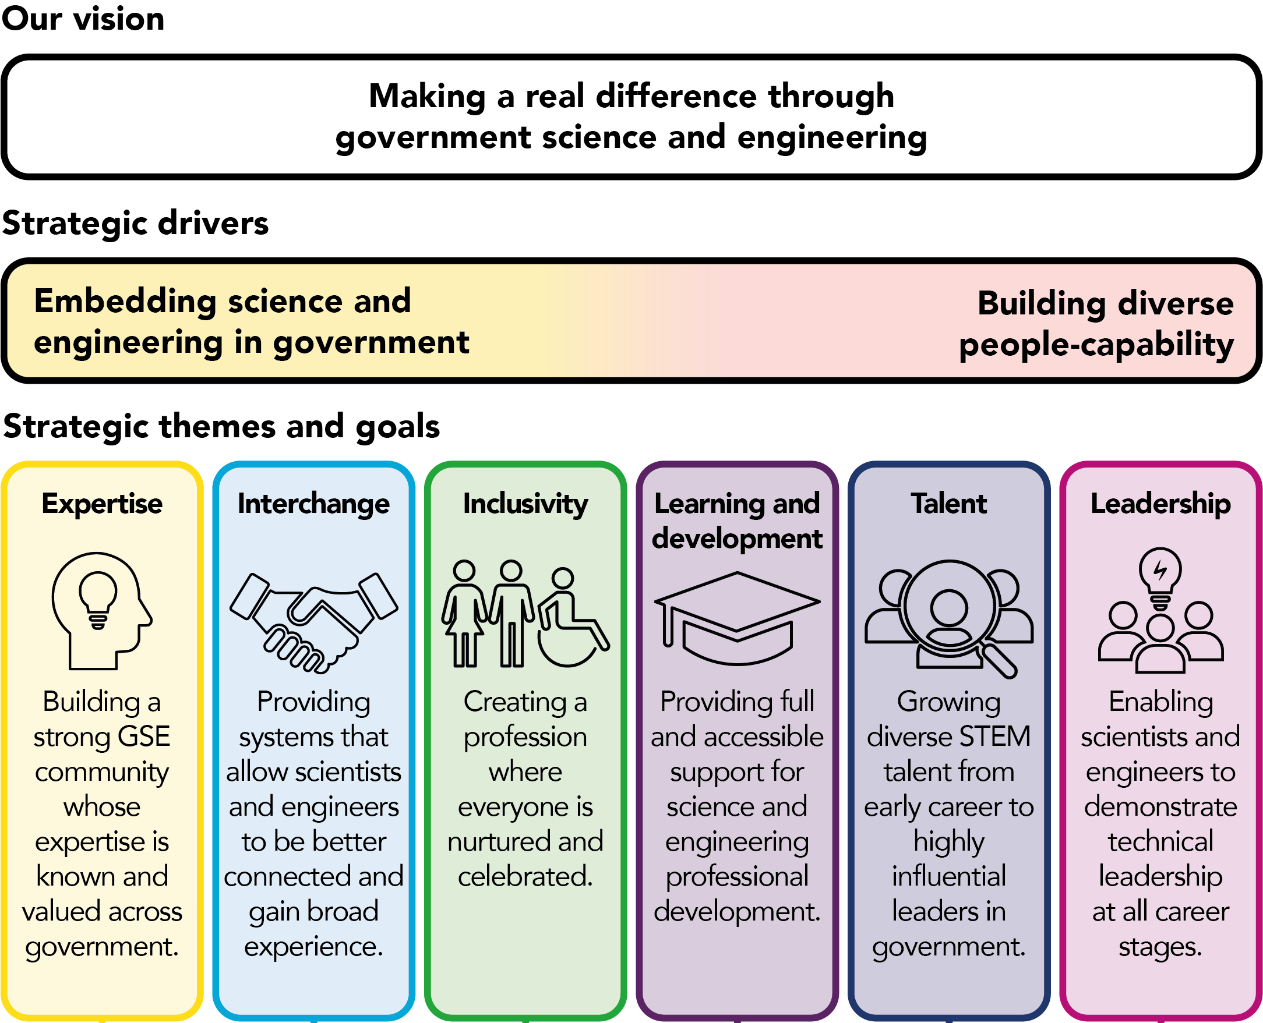
Our motivation – GSE strategy
An action in government reform is on encouraging high demand skills within government. A key part of this is enabling movement in and outside of government.
Better knowledge exchange schemes meets both strategic drivers in the latest GSE Profession Strategy.
We look at this from two angles: expertise and interchange.
Notes:
As part of the Declaration on Government Reform, Sir Patrick Vallance co-owns an action to review how to encourage specific high demand skills, particularly scientists and engineers to work within government. A key part of meeting this action, is reviewing and improving how we can enable movement and knowledge exchange scientists and engineers in and out of government.
Considering these wider priorities, and from feedback from GSE members, better STEM knowledge exchange programs in and out of government is a key focus of the latest GSE Profession Strategy. We believe that effective knowledge exchange programs based on placing scientists and engineers in schemes related to either other technical areas, or in policy teams, really supports both strategic drivers in the GSE strategy. Both ensuring we embed science and engineering in government through informed policy and decision making, and also providing a way to build our diverse members’ capability by developing specialist and/or policy skills through working in different sectors covering government, academia and industry.
The two specific themes from the strategy I’m going to talk about now are expertise and interchange. For both themes, I’m going to go through the current activity going on in the GSE profession and let you know of existing opportunities to get involved.

Slide 4
Our activities – Expertise
Two main ongoing activities to track and know where our expertise is across government:
Developing a central taxonomy for GSE specialist areas of expertise
Self-recording and tracking skills assessment tool
Notes:
We think a key barrier to allowing scientists and engineers to be either embedded in policy teams, or to developing their technical skills in other sectors, is the highly complicated way we talk about our specialties!
Lots of different government departments, labs and teams all refer to capabilities, skills, specialisms as different things. Even universities don’t have a standard language for STEM skills so there is no current central way to talk about them.
The GSE Profession has recently done some work with Dstl fellows to try and develop an agreed central list of technical expertise. Our list was mapped across by Dstl fellows, to their own reference system (termed capability elements), and it was found to be successful. We are hoping to continue this exercise with public sector research establishments all across government, with Dstl as an example. We hope providing a transparent catalogue of how each organisation, or eventually departments, maps their own reference system to a central scheme, will allow people to more easily see how their expertise aligns to others across government.
We are also using this central list as a way to record expertise against, using the GSE skills assessment tool. The GSE skills assessment tool is an online tool where each GSE member gets their own account and can log in to store evidence against their technical skills. This is really helpful for personal development, but also allows us to see what areas of expertise our members have.
Our long term ambition is for all GSE members (if they are interested in gaining experience in other areas) to use this tool to noted down their areas of expertise. From there, representatives from each department will be able to see those who have noted their expertise and contact them should they receive an ask for a certain type of expertise.

Slide 5
Our activities – Interchange
We are scoping:
What schemes currently exist
Barriers to placements
What scientists and engineers want from these schemes
Long-term ambition to have two schemes:
A scheme for scientists and engineers to improve their technical skills through learning from different sectors and areas of government.
A scheme were scientists and engineers can better engage with policy professionals.
Notes:
In order to provide better systems that will allow scientists and engineers to gain broad experience across different sectors, we have been reaching out across government, academia and industry through a wide-reaching survey. This survey has helped us understand people’s views on what STEM-related schemes currently exist, what works with them, what barriers exist, and what scientists and engineers would want from future schemes.
We want to use this evidence to build on our engagement with the government centre, who are looking at porosity, and trying to influence their work to ensure it is suitable for scientists and engineers. We are also aiming to harness this relationship to promote existing, working schemes more widely across government.
Finally, we want to use these findings to develop two types of knowledge exchange placements aimed at scientists and engineers: 1) placing people across different sectors in their area of technical interest in order to gain broader technical experience and learn about other sectors. 2) A scheme where scientists and engineers can be connected to, or embedded within, a policy-making team where they can develop communication, translating, and other related skills. This scheme will also help strengthen that use of expertise within policy.

Slide 6
Our activities – STEM Futures
STEM Futures is an established partnership of 21 organisations across industry, academia, and the public sector.
Supports those in STEM roles in developing their technical skills, knowledge and experience.
Currently seven technical hubs (subject-based communities of interest/practice) including data and quantum.
Notes:
An example of a scheme that already exists and fulfils the description of scheme 1) i.e. placing scientists and engineers in areas of technical interest across and outside of government is called STEM Futures.
The scheme has 21 established partners across industry, academia, and the public sector as shown on the screen. It aims to support individuals working in STEM roles with the development of technical skills, knowledge and experience through on-the-job learning via placements supplemented by education.
Placements and other learning experiences are based on the technical area of interest of the applicant. There are currently seven areas (termed technical hubs), covering: data, quantum, reliability, sensing, space, weapons, ordnance, munitions and explosives.
STEM Futures was originally established and co-ordinated by Dstl, but this co-ordination role is moving over to the GSE Profession within Go-Science. The scheme has been an incredible success so far, and we are hoping to take it forward by engaging more partners, potentially establishing new technical hubs, and promoting it wider across government.

Slide 7
Q&A - Panel discussion
Dr Richard Burguete
Director of the Postgraduate Institute for Measurement Science, National Physical Laboratory (NPL) Ask me about
Reducing barriers for knowledge exchange such as the STEM Futures scheme
Challenges of maintaining S&E expertise within government
Simon Brindle
Director of Covid Restart and Recovery, and Welsh Government Head of Policy Profession Ask me about
Encouraging policymakers to seek S&E advice
Embedding S&E experts into policy teams
Notes:
We are now turning to the questions and answers portion of the session. We have two panellists for you to engage with, both with their own area of expertise.

Slide 8
Thanks for your time!
Please fill out the post session evaluation survey
This is a chance to capture your knowledge of existing secondment programmes and your views on them.
Notes:
Thank you for attending our session today, we really appreciate your time.
To gain as much insight as possible into developing knowledge exchange programs that will really work for you, please do complete our post session evaluation survey!

