Slide 1
GSE Learning & Development
Marie Kakhu – GSE Skills, Learning & Development Lead

Slide 2


Intro…what is science & engineering?
From generating and evaluating evidence, creating new standards to working with policy – the breadth of roles and experience within the Government Science & Engineering (GSE) profession is vast
Our vision is to make a real difference in government through science and engineering
To truly make a difference in government, our two priorities are:
    More use of science and engineering in government - Identifying and championing our internal science and engineering expertise to provide the best input into decision making.
    Building diverse people capability – Enabling our diverse range of scientists and engineers to achieve excellence.

Slide 3
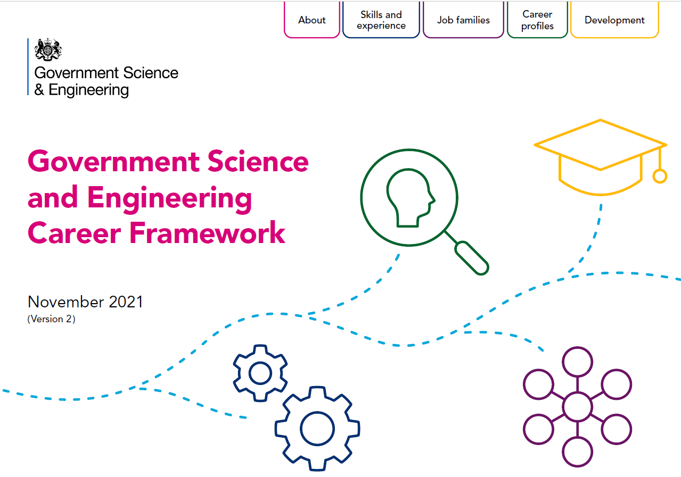
GSE Career Framework
Describes GSE technical skills
Describes GSE roles
For individuals, managers and recruiters
Helps you reflect on your GSE career direction
4 job families/career pathways:
GSE affiliate
GSE cross-discipline
GSE specialist
GSE deep specialist
5 technical skills groups:
Building and applying knowledge
Communicating S&E for government
Developing the S&E community
Technical oversight and management
Broad thinking

Slide 4
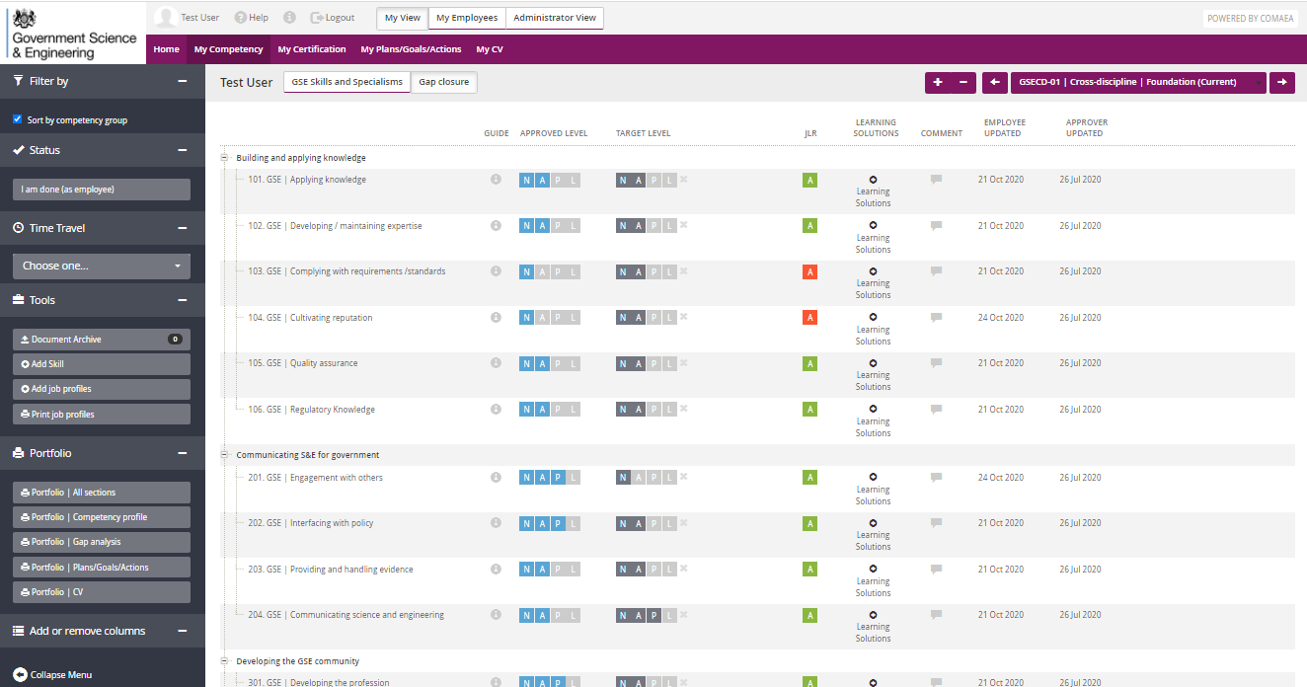
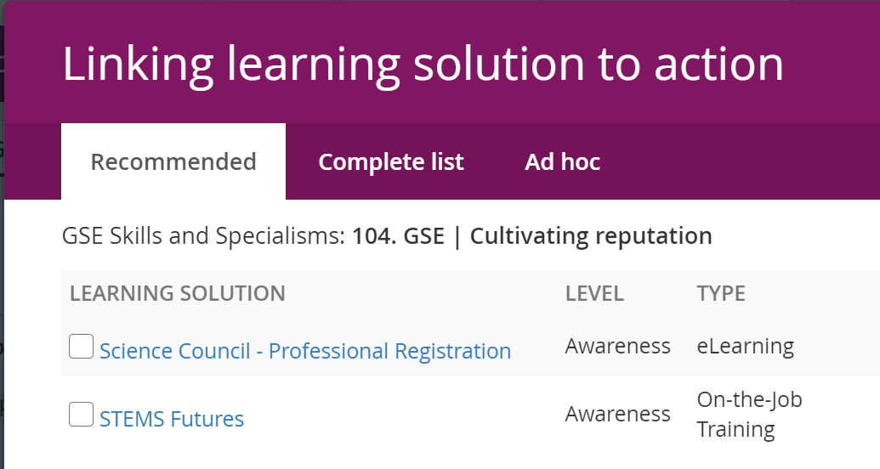
GSE Skills Assessment Tool & GSE L&D Champions
Track your GSE technical skills
Look at the L&D connected to each skill
Bring to your PDP meetings as a great tool to talk about the skills – we strongly encourage you to share with your manager/mentor as part of your development
Record your specialisms

Slide 5

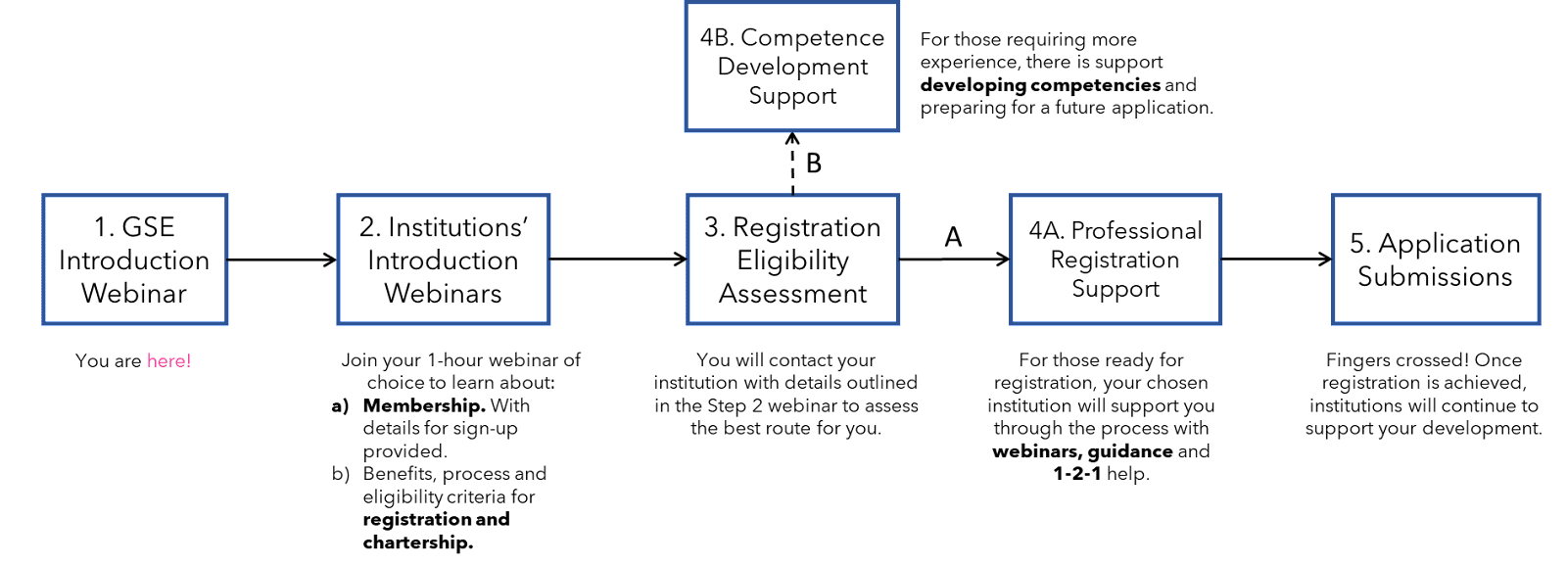
GSE Professional Recognition
Science Council - What are the benefits of becoming professionally registered?
Institution of Engineering and Technology - 5 Reasons why you should consider IET membership!

Slide 6

GSE Science & Engineering 101
Science & Engineering 101 (S&E 101) available for the whole civil service, made up of 3 components:
  GSE induction
  GSE signposting hub
  Two online Science & Engineering literacy modules:
    Using science & engineering
    Communicating science & technical advice

Slide 7


GSE mentoring in development
GSE Professional Recognition Offer
GSE Peer Mentoring
GSE Leadership

Slide 8

Any questions?
Contact:
gse@go-science.gov.uk
marie.kakhu2@go-science.gov.uk

