Slide 1
Introduction to the GSE Diversity and Inclusion Action Group

Slide 2
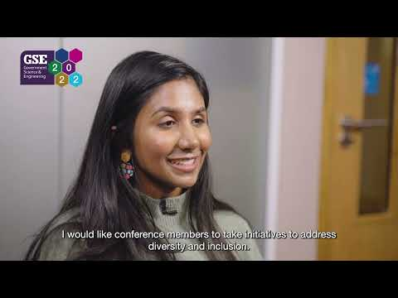

Slide 3
Introduction to the GSE Diversity and Inclusion Action Group
Session hosts
Diane Ashiru-Oredope
Vicki Chalker
Panel members
David Kenyon
Christine Maggs
Rameya Arulanantham
Louise O’Sullivan
Kirsty McBeath

Slide 4
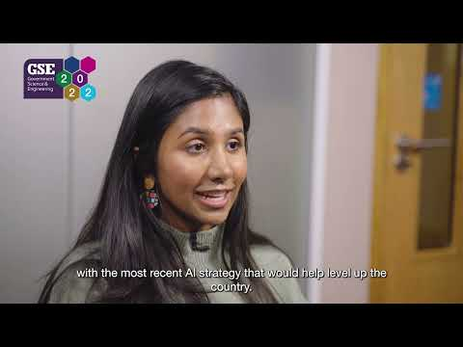

Slide 5
Thank you GSE Profession Diversity and Inclusion Strategy
- - - - - - - - - - - - - - - - - - - - - -

