Slide 1
Advancements in Artificial Intelligence and Data Science: What does this mean for Government?
Professor Mark Girolami
Chief Scientist, The Alan Turing Institute

Slide 2
Founding the Institute
“We will found The Alan Turing Institute to ensure Britain leads the way again in the use of big data and algorithm research”
George Osborne, Chancellor of the Exchequer Budget Speech, March 2014

Slide 3
Goals
Advance world class research and apply it to real-world problems
Train the leaders of the future
Lead the public conversation

Slide 4
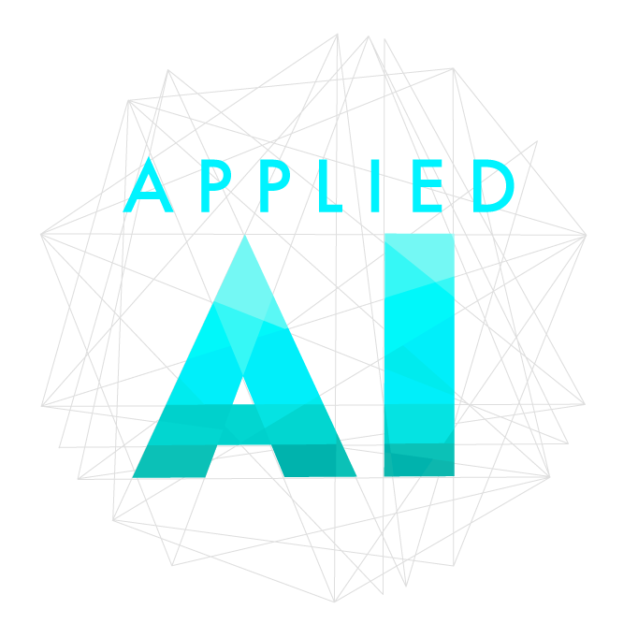
Funder
Delivery
Research
Advisory
Regulation
Advocacy
Policy

Slide 5
What’s coming over the Horizon?
Cyber-Physical Infrastructure
connected networks of cyber-physical systems (e.g. digital twins, robotic systems
networks of applications will likely form around particular use cases, with interoperability supporting a connected ecosystem of those networks
could provide a step change in the economic and social value of these individual systems

Slide 6
What’s coming over the Horizon?
Foundational models
Very large neural network models; unsupervised training
Embody substantial general expertise, which can be specialised with further training, and can be used for generating natural language dialogues, computer code, mathematical proofs, or even music
We have become used to AI systems that are narrow and deep: foundation models give us broad and shallow expertise
Answers not necessarily trustworthy: but can quickly give us plausible candidate solutions

Slide 7
Policy for AI and data science
Use data science and artificial intelligence to inform policy-making
Improve the provision of public services
Build ethical foundations for the use of data science and AI in policy-making
Contribute to policy that governs the use of data science and AI

Slide 8
“As we prepare for new challenges ahead, we are presented with the opportunity to supercharge our already admirable starting position on AI and to make these technologies central to our development as a global science and innovation superpower”
Kwasi Kwarteng, Secretary of State for BEIS, National AI Strategy 2021

Slide 9
Government Data Science Festival
Turing Lectures
AI UK
Skills for AI and data science
Data Skills Taskforce
Data Study Groups

Slide 10
Thank you mgirolami@turing.ac.uk

