Slide 1
Women & Allies in STEM

Slide 2
What is an Ally?
An ally is someone who is not a member of an underrepresented group but who takes action to support that group and thus challenges behaviour
Act as a sponsor
Be a champion
Amplify
Advocate
Be a scholar
Be an upstander
Be a confidant
Notes:
You have probably heard of being an ally or allyship as it has been gaining a lot of attentions.
My favourite example of allyship is in relation to the suffragettes, they could protest and march but they needed allies, the men in power, to vote for the change in the law that allowed women to vote.
You can help create change, it’s up to people who hold positions of privilege to be active allies to those with less access, and to take responsibility for making changes that will help others be successful. Active allies utilize their credibility to create a more inclusive workplace where everyone can thrive, and find ways to make their privilege work for others. It doesn’t have to be hard, it can be simple everyday efforts that add up.
How to Act as a Sponsor
Talk about the expertise you see in others, especially during performance calibrations and promotion discussions.
Recommend people for stretch assignments and learning opportunities.
Share colleagues’ career goals with influencers.
Eg “What I learned from Karen is the following...”
How to Act as a Champion
Direct questions about specific or technical topics to employees with subject-matter expertise instead of answering them yourself.
Advocate for more women, people of color, and members of other underrepresented groups as keynote speakers and panelists.
If you’re asked to keynote or serve in a similar public role and know someone from an underrepresented group who’d be an equally good fit (or better), recommend that person (after asking them first if they’d like to be put forward).
Eg Since then, the nonprofit organization GenderAvenger has created a pledge to reduce the frequency of all-male panels at conferences and events. It reads, “I will not serve as a panelist at a public conference when there are no women on the panel.” Anyone can sign the pledge on their website.
How to Act as an Amplifier
When someone proposes a good idea, repeat it and give them credit. For example: “I agree with Helen’s recommendation for improving our net promoter score.”
Create a code of conduct for meetings and any shared communication medium including email, chat, Slack, and so forth.
Invite members of underrepresented groups within your company to speak at staff meetings, write for company-wide newsletters, or take on other highly visible roles.
How to Act as an Advocate
The Advocate recognizes and addresses unjust omissions, holding their peers accountable for including qualified colleagues of all genders, races and ethnicities, abilities, ages, body shapes or sizes, religions, and sexual orientations.
Look closely at the invite list for events, strategic planning meetings, dinners with key partners, and other career-building opportunities. If you see someone from a marginalized group missing, advocate for them to be invited.
Offer to introduce colleagues from underrepresented groups to influential people in your network.
Ask someone from an underrepresented group to be a co-author or collaborator on a proposal or conference submission.
How to Act as a Scholar
When an ally takes on the role of the Scholar, that ally seeks to learn as much as possible about the challenges and prejudices faced by colleagues from marginalized groups
Investigate and read publications, podcasts, or social media by and about underrepresented groups within your industry.
Ask co-workers from marginalized groups about their experience working at your company.
If your company or industry has specific discussion groups or Slack channels for members of underrepresented groups, ask if they’d be comfortable letting you sit in to observe. Asking is essential: Your presence may cause members to censor themselves, so be sure to check in before showing up.
How to Act as an Upstander
The Upstander is someone who sees wrongdoing and acts to combat it.
Always speak up if you witness behavior or speech that is degrading or offensive. Explain your stance so everyone is clear about why you’re raising the issue.
In meetings, shut down off-topic questions that are asked only to test the presenter.
Take action if you see anyone in your company being bullied or harassed. Simply insert yourself into a conversation with a comment such as, “Hi! What are you folks discussing?” and then check in with the victim privately. Ask if they’re okay and if they want you to say something.
How to Act as a Confidant
creates a safe space for members of underrepresented groups to express their fears, frustrations, and needs. Simply listening to their stories and trusting that they’re being truthful creates a protective layer of support.
Believe others’ experiences. Don’t assume something couldn’t happen just because you haven’t personally experienced it.
Listen and ask questions when someone describes an experience you haven’t had. Don’t jump in with your own personal stories.
If you’re a manager, hold regular “office hours” encouraging all of your team members to speak with you about issues that are troubling them.
Remember its ok to mistake, the important thing is to keep trying, acknowledge the wrong doing, stating that you can do better and correct your course. Listen and Learn

Slide 3
Building Allyship
Angela Booth
Chair of the Women’s Network & Head of Operational Excellence

Slide 4
We need allies…
Redressing gender equality
In FTSE250 businesses, men make up 82% of executive directors (Ernst & Young, 2021)
Women still experience unequal treatment and discrimination:
>40% women experience sexual harassment at work in the UK (WRDA, 2021)
Of employees working full time in the UK, women are paid 7.9% less than men on average (ONS, 2021)
Women are over-mentored and under-sponsored compared to men (HBR, 2019)
96% of organisations are more successful when men are engaged with inclusion (Forbes, 2018)
Allyship makes people feel twice as likely to belong in their place of work (Forbes, 2021)

Slide 5
Allyship in action
A model approach
“
“
Become educated on gender equality
What I learnt was that I don't need to know it all; but to recognise that
there are still issues and it's important to know about it and take action
Understand the lived experience of women
“
“
I didn’t understand the issues blocking the talent pipeline.
Now I know how to develop diverse talent to increase diversity in my lead team
Take action and be publicly accountable
“
“
I thought I used to support gender equality… I realise now that supporting in theory means nothing without tangible actions

Slide 6
Role Models and Allies
Zeb Farooq
Principal Bid Manager & Women@Amey Committee Member

Slide 7
Role Models And Allies
Role Models & Allies inspire people
Celebrate women’s achievements
Powerful and relatable Role Models & Allies who are visible, active and accessible
Raise awareness about women’s equality
Everyone has a role to play in forging a more gender balanced world
Accelerate gender parity

Slide 8
Challenges In The Muslim Community
Muslim women are mistreated
Muslim women experience the greatest economic disadvantages
Discrimination, negative stereotypes and cultural barriers
Wrong to hide behind our successful past
We can’t hold back half the talent of the planet

Slide 9
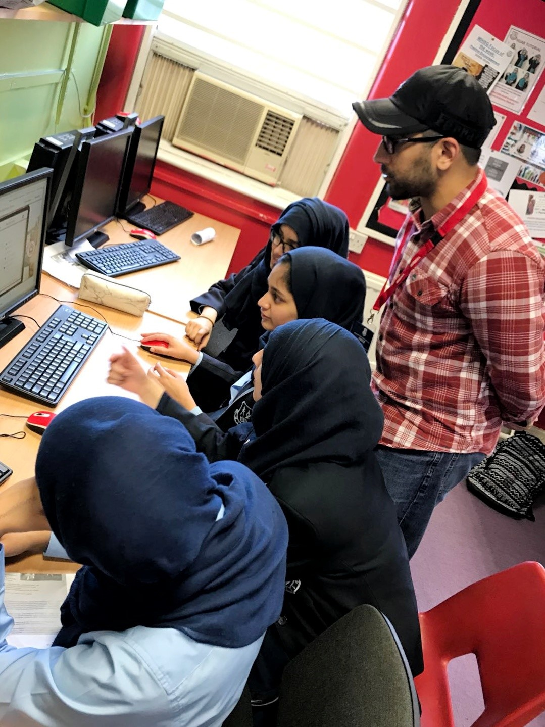
What I Do
Personal involvement with The Prince’s Trust
Improve young people’s self-confidence, self-efficacy and employability
Sharing experiences with young people

Slide 10
Becoming And Being A Male Ally
My faith - Islam
My maternal uncle
Giving back to and caring about our communities
Leaving a legacy
Speed Mentoring
Engagement
Conferences
Business Leadership
Local Communities
Collaboration with other organisations
Women@Amey Leadership Development Programme

Slide 11
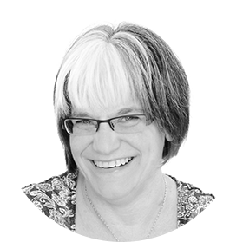
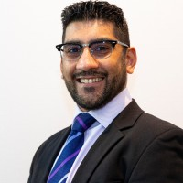
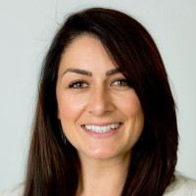
Panel Discussion
Clair Collins
Head of Products & Services WISE
Zeb Farooq
Principal Bid Manager Amey Consulting
Angela Booth
Head of Operational Excellence Thames Water

Slide 12
Top 3 actions
Get to know women in your extended teams
Use your platform to make change
Mentor and sponsor women about business
Understand their lived experience, and show them you’re committed to gender diversity and inclusion
Address micro-aggressive behaviour, embed inclusive recruitment and pay practices as standard
Close knowledge gaps and support progression of female talent. Support girls to continue in STEM

Slide 13
Zeb’s Positive Actions
Engage with your I&D and Leadership groups within your organisations
Collaboration!!!
Join your gender equality employee network
My simple call to action is:
If you’re already involved, then stay involved and get others involved too
If you’re not involved, then get involved
In the Arabic language the word for the:
Sun is “Ash-shams” and is feminine
Moon is “Qamar” and is masculine
The sun burns itself to give life and light to everything
The moon just reflects the light. Within itself, it has no light; it just radiates the brilliance of the sun.
So when we shine as men, we are just reflecting the glorious light of our women.

Slide 14
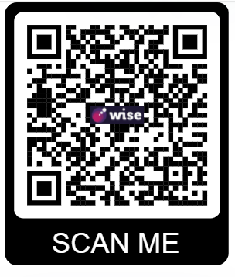
Your WISE Membership
As a member of the GSE, you have support year-round through with:
Benchmarking and access to our annual Measuring Progress Event
Senior Leadership Events
Knowledge Sharing Events
The WISE Conference
Access to research
White papers
Case studies and best practice in the online WISE members area
Webinars and access to our library of recorded content
Extensive networking opportunities
Inspiring & inclusive campaigns
Access to our expert team
www.wisecampaign.org.uk/register

